Slide 1


Slide 2
Design and Implementation of a Databot Based on Association Rule Mining
University of Salahaddin
College of Engineering
Electrical Engineering Department
Polla Abdulhamid Fattah

Slide 3




Discovering Knowledge from Data
  As the world goes to be more complex physically, more complex human activities are introduced. Enterprises have to deal with a huge amount of data in there daily actions.
  Thus decision makers are in need for data classification and finding valuable information hidden inside raw data. This situation has been described as data rich but information poor .
  This need for information leads to mine knowledge inside huge amounts of data by using special techniques because traditional techniques (simple query or manually) was unfeasible. Thus data mining can be viewed as a result of the natural evolution of information technology.

Slide 4


Data Mining
Data mining is the process of finding Knowledge from raw data. There are various definitions for data mining according to whom defined it. But most popular definitions is:
  Data mining is the process of exploration and analysis, by automatic or semiautomatic means, of large quantities of data in order to discover meaningful patterns and rules.

Slide 5









Data Mining Tasks
uses some variables to predict unknown or future values of other variables
Classification
Groups records to a set of predefined categorical variable
Directed (predictive)
Estimation
Similar to the classification but target variable is numerical
Prediction
Similar to Classification but results lie in the future
Data mining
Association Rules
showing attribute-value conditions that occur frequently together
Clustering
Is Similar to Classification but no target classes are specified
Indirected (descriptive)
finds human-interpretable patterns that describe data
Description and Visualization
Simply try to find ways to describe patterns and trends lying within data

Slide 6

Association Rules
Association Analysis is a technique for discovering association rules showing attribute-value conditions that occur frequently together in a given set of data. Association analysis is widely used in transaction data analysis.
Mathematically association rules are of the form:
X → Y,
X₁ ^ … ^ X_{m} → Y₁ ^ … ^ Y_{n}”, where X_{i} (for i [1,…,m]) and Y_{j} (for j [1,…,n]) are attribute-value pairs.
The association rules X →Y is interpreted as database records that satisfy the condition in X are also likely to satisfy the conditions in Y.
The interestingness degree for any association rule can be measured by two criteria which they are minimum support and minimum confidence thresholds.

Slide 7




Association Rules cont.
Support count for itemset i is the number of itemsets that contain i as a subset in the database.
Support =
    Confidence Measures how often items in B appear in transactions that contain A for
  Frequent Itemset is an itemset whose support is greater than or equal to a minimum suport threshold

Slide 8

Association Rules Approach
To find strong association rule between items there are two steps has to be applied. Which are:
  Frequent Itemset Generation: Generate all itemsets whose support ≥ minsup [this is computationally expensive]
  Rule Generation: Generate high confidence rules from each frequent itemset.
There are many algorithms for generating association rules but the most widely used is apriori algorithm and its variations for generating frequent itemsets.

Slide 9

Apriori Algorithm
Scan the transaction database to get the support S of each 1-itemset,
compare S with min_sup, and get a set of frequent 1-itemsets, L₁
Scan the transaction database to get the support S of each candidate k-itemset in the final set, compare S with min_sup, and get a set of frequent k-itemsets, L _{k}
Use L _{k-1} join L _{k-1} to generate a set of candidate k-itemsets. And use Apriori property to prune the unfrequented k-itemsets from this set
No
The candidate set = Null
Yes
For every nonempty subset s of l,
output the rule " s => (l-s)" if its confidence ≥ min_conf
For each frequent itemset l, generate
all nonempty subsets of L

Slide 10
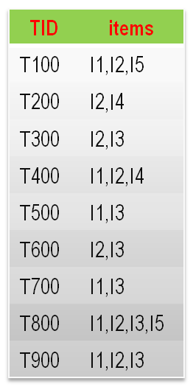

An Example
C1
L1
Itemset | S.C
I1 | 6
I2 | 7
I3 | 6
I4 | 2
I5 | 2
Itemset | S.C
I1 | 6
I2 | 7
I3 | 6
I4 | 2
I5 | 2
Compare candidate support count with minimum support count
Scan D for count of each candidate
Min_Sup_count = 2
Database D
C2
Itemset
I1,I2
I1,I3
I1,I4
I1,I5
I2,I3
I2,I4
I2,I5
I3,I4
I3,I5
I4,I5
Itemset | S.C
I1,I2 | 4
I1,I3 | 4
I1,I4 | 1
I1,I5 | 2
I2,I3 | 4
I2,I4 | 2
I2,I5 | 2
I3,I4 | 0
I3,I5 | 1
I4,I5 | 0
L2
Itemset | S.C
I1,I2 | 4
I1,I3 | 4
I1,I5 | 2
I2,I3 | 4
I2,I4 | 2
I2,I5 | 2
Generate C2 candidates form L1
Scan D for count of each candidate
Compare candidate support count with minimum support count
C3
C3
Compare candidate support count with minimum support count
L3
Generate C3 candidates form L2
Scan D for count of each candidate
Itemset | S.C
I1,I2,I3 | 2
I1,I2,I5 | 2
Itemset | S.C
I1,I2,I3 | 2
I1,I2,I5 | 2
Itemset
I1,I2,I3
I1,I2,I5

Slide 11


An Example cont.
for frequent itemset {I1, I2, I5} min_Confidence = 70%.
  I1 ^ I2 ⇒ I5, confidence = 2/4 = 50%
  I1 ^ I5 ⇒ I2, confidence = 2/2 = 100%
  I2 ^ I5 ⇒ I1, confidence = 2/2 = 100%
  I1 ⇒ I2 ^ I5, confidence = 2/6 = 33%
  I2 ⇒ I1 ^ I5, confidence = 2/7 = 29%
  I5 ⇒ I1 ^ I2, confidence = 2/2 = 100%

Slide 12

Limitations of Apriori Algorithm
It requires many scans (full scan for each iteration) for database which it means more data transaction.
If it is required to change minimum support value, the algorithm should rerun from scratch.
It is not an accumulated algorithm which means for new inserted data the algorithm should rerun from start.
While it scans database for more frequent itemsets let say at k-itemset, it may loose important association rules which that may occurs at m-itemset when 1 < m < k.

Slide 13

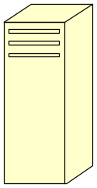


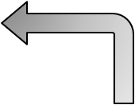



The Proposed Databot
Databot is an engine for finding useful information (association rules) from a huge amount of raw data. It can be run on a single database or a distributed databases. Its strategy is using more memory (main memory “RAM” and secondary memory “hard disk”) for the sake of speed up the process.
Databot
Netbot
Analyzer
Frequency -base
Database(s)
End User

Slide 14


The Aim of the Study
  Design and implement of a new association rule mining called Databot. The Proposed Databot has the following prosperities.
    Instead of frequent itemset generation it generates support count for all itemsets, without using any pruning by min_support.
    It adds a new layer of abstraction by saving support count of itemsets in a database. this abstraction layer makes databot more faster by
      Generating rules from support count of itemsets instead of raw data.
      For next run it can be start at the last scanned stop.
    Adds an abstraction level for items.

Slide 15

Our Databot Architecture
User Interface
Commands
Association Rules
Analyzer
Queries
Coded Itemset, Frequency
Frequency-base
Reference Table
Coded Itemset, Frequency
Netbot
Item, code
Data
Databases

Slide 16




1. The Netbot
Data from Databases
Sorted itemsets according to their codes
NetNavigator
Reference Table
Itemset Generator
(Itemset, frequency)
Frequency-base Creator
(Itemsets, frequencies) of the buffer
To and from frequency-base

Slide 17

1. Netbot cont.
  Netbot is responsible for:
  fetching data (Transactions) from various databases (which have transactional tables)
  Cleaning and sorting transactions according to the Reference Table
  Generating Subsets of the itemsets in a transaction.
  Saving every (itemset, frequency) pairs in the Frequency-base

Slide 18

2. Reference Table
Reference table is a table with two fields first contains item name and second contains item number. Reference table is used to replace actual item name with a numeric code witch is better for:
    Less storage required.
    Easier to sort.
    Gives an abstraction layer.
    Consistent itemset codes between deferent databases
Item name | code
Pepsi cola | 1
Coca cola | 1
Makah cola | 1
Bread | 2
Alutor tea | 3
Ahmed tea | 3

Slide 19

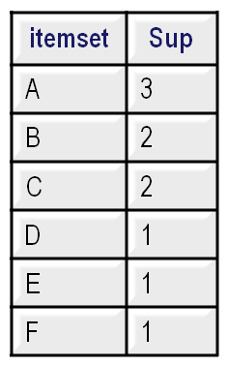
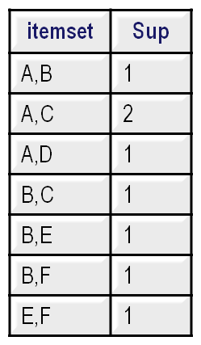
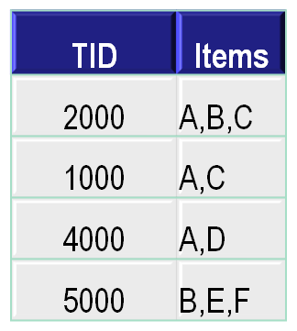
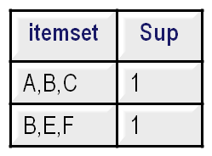


3. Frequency-base
Frequency-base is a database consists of a number of table equal to the largest itemset length limit. Each table contains frequencies for k-itemsets where k = 1, 2, 3, …, largest itemset.
3-Itemset
1-Itemset
2-Itemset

Slide 20

4. The Analyzer
Frequency-base
(itemset, frequency
Fetch (itemset, frequency)
Group of (itemset, frequency) pairs
RuleGenerator
Coded Rules
Reference Table
Decoding
Readable Rules

Slide 21

4. The Analyzer cont.
Analyzer is responsible for generating association rules according to given minimum support and minimum confidence by sending queries to Frequency-base, analyzer can generate :
  Association rules from any k-itemset.
  Association rules for only selected itemset.
  And also strong rules from frequent itemsets “Apriori simulated result”.

Slide 22


Verifying Databot
There are many verification approaches in Software Engineering point of view. In this thesis, a comparison method is used to see the accuracy of our proposed and implemented Databot.
In this Study an example of Jiawi and Michelines’ book “Data Mining: Concepts and Techniques” is used as a benchmark to make our verification for the two parts of the Databot individually.

Slide 23
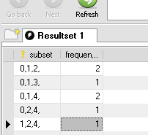
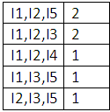
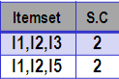

Verifying Netbot
a- Manual Result
b- NetBot Result
Item | Code
I1 | 0
I2 | 1
I3 | 2
I4 | 3
I5 | 4
c- Jiawi’s Results
Reference Table

Slide 24
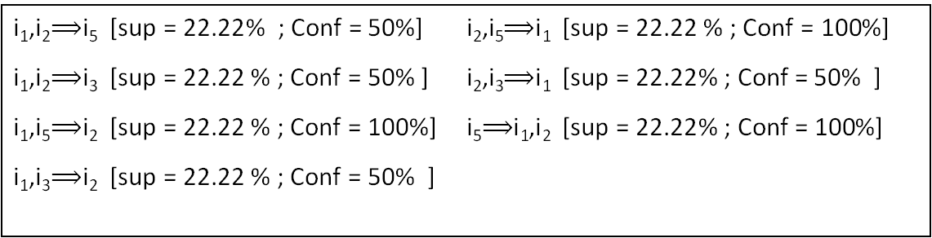
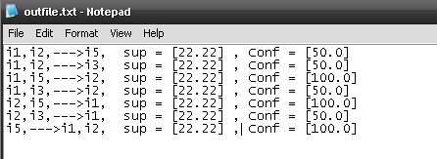

Verifying Analyzer
a- Manual results
b- Analyzer’s result

Slide 25

Testing Databot On Real Database
Test Seting:
Infrastructure
  The server computer: HP computer with Intel core due CPU at 2.16GHz speed and 1 GB main memory.
  The client computers: two locally collected computers with Intel Pentium 4 at 3 GHz speed and 512 MB main memory are used.
  The underlying network: 100 mb/s network adapters with FTP CAT 6 are used to connect computers with a switch by using star topology.
  The software: all computers’ operating systems are Windows XP SP2, The database servers are MySql Essential (Version 5.0.27), and Java JDK (version 1.5) and JDBC mysql-connector-java (Version 5.0.4) are used.
Data: A fraction of Kok supermarket in Erbil of one weak is considered. The data it consists of nearly 15000 records with 600 items.

Slide 26
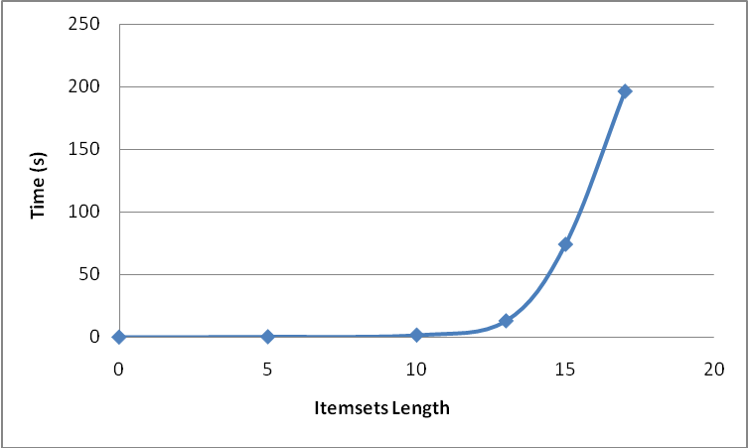

Testing Netbot
After fetching data from client computers and saving there frequencies in the Frequency-base. We find that, Time requirement for generating frequencies of subsets are related exponentially with the maximum allowed transaction length

Slide 27
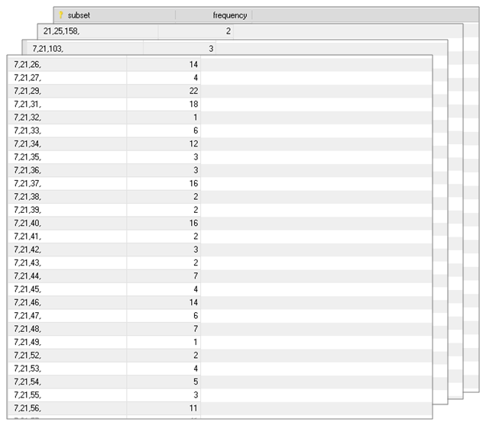

Frequency-base Contents

Slide 28

Testing The Analyzer
Analyzer has been applied to the output of the NetBot. Three different types of tests are carried out to generate special rules accordingly. The type of rules are :
Rule Generation for Selective Itemsets
Rule Generation for Selected Length of Itemsets
Rule Generation for Apriori Simulation

Slide 29

Rule Generation for Selective Itemsets
Test 1: items selected {biscuit, honey, jelly}
Time required: 31 ms
      biscuit, honey ⟹jelly sup = [0.07] , Conf = [5.55]
      biscuit, jelly ⟹honey sup = [0.07] , Conf = [5.26]
      jelly, honey ⟹biscuit sup = [0.07] , Conf = [100.0]
      honey ⟹biscuit, jelly sup = [0.07] , Conf = [2.17]
      biscuit ⟹jelly, honey sup = [0.07] , Conf = [0.15]
      jelly ⟹biscuit, honey sup = [0.07] , Conf = [3.7]
Test 2: items selected { syrup, soap }
Time required: 17 ms
      syrup ⟹ soap sup = [0.61] , Conf = [1.7]
      soap⟹ syrup sup = [0.61] , Conf = [21.05]

Slide 30
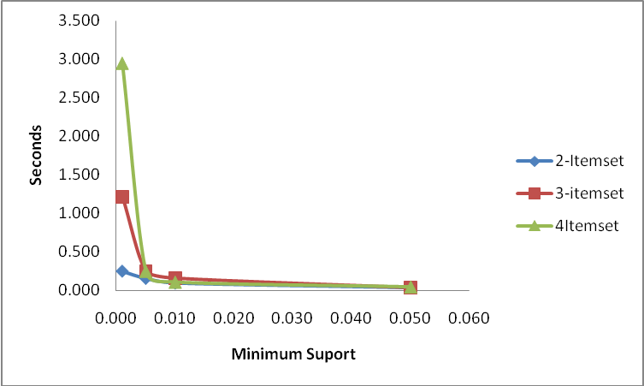

Rule Generation for Selected Length of Itemsets

Slide 31

Rule Generation for Apriori Simulating
Minimum Support | Itemset Length | Time (Seconds) | No. of Rules
0.001 | 11 | 17.016 | 1942
0.005 | 5 | 8.00 | 67
0.01 | 4 | 3.859 | 52
0.02 | 4 | 3.219 | 3
0.03 | 3 | 0.563 | 15
0.04 | 3 | 0.109 | 9
0.05 | 3 | 0.093 | 2

Slide 32

Conclusions
By applying a strategy of splitting the Databot into two separate parts and running each part in distinct time, the time needed for the rule generating phase has been reduced significantly (from 200 s to 17 s).
Using Frequency-base database with the Netbot and the Rule Generator makes running the Analyzer very fast. Also, this technique leads to flexibility in rule selection and generation, because there is no need for re-running the Databot from the scratch.
Using Java as a programming language in data mining is very powerful approach because of its OO characteristic and its speed for internal data mining calculations.
Results show that the only limitation of our Databot is its restriction in itemset length. But in most applications, the itemset length does not exceed 7 to 13, a length which our Databot is quite efficient.

Slide 33


